Slide 1
Autonomous Mobile Robot Navigation using the iRobot Roomba
Supervisor: Prof. dr. ir. P. Slaets
Co-Supervisor: Prof. dr. L. Vandeurzen
Kevin DENIS
Alexander MEYNEN
Notes:
Welcome !
My name, thesis partner …

Slide 2
Agenda
Goals
Introduction
Robotic platform
Methods
Demonstration
Critical reflection
Future work
Notes:
Brief overview
Describing Goals of the thesis
Short introduction about AMR.
Discuss tool achieve goal, being
extended robotic platform
autonomous methods
Demonstration show final results
On which we will afterwards make a critical reflection
Close presentation giving few comments about possible future work.

Slide 3
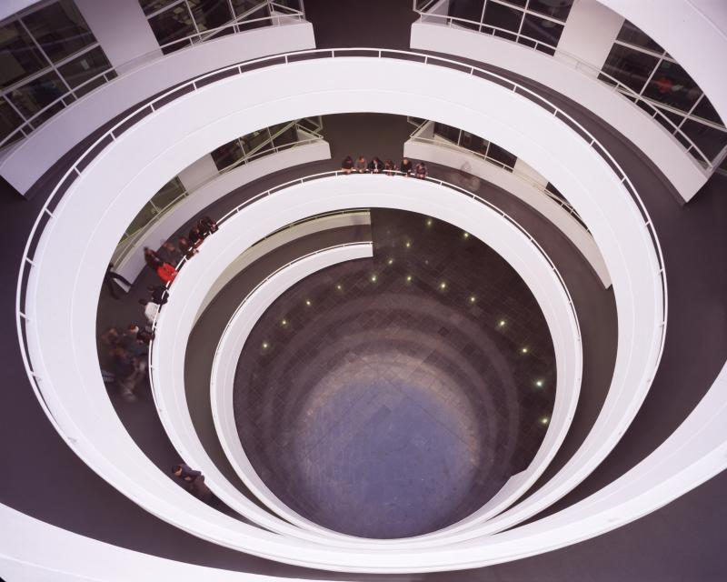
Goals (Application)
Guidance of a visitor to the entrance of a room, in Group T
Notes:
Final goal achieve AN.
This guiding a visitor of Group T to a desired room
Special architecture “robot friendly”
Floor with a spiral : no stairs to go from one floor to another.
No “floor” but “module”.
quarter of the spiral, in which class rooms are located.
Final video show you
Robot going from a start position to the front of a desired class room.
Robot presumes obstacles static, so pedestrians careful to a certain degree.
Robot won’t be aware if the visitor is still following him. Roomba is slower not a major problem.

Slide 4

Goals (Design)
Roomba
Cable + Interfacing
Selecting and implementing algorithms
for autonomous navigation
Using maps of Group T
MATLAB
Extend Roomba with extra sensors
Design of an extended platform
Notes:
Achieve application, comments about Design
Create interfacing between the Roomba and the computer,
Making a cable
Using the serial communication settings
Chose and implement AN algorithms, knowing that
Maps of Group T
Methods implement in MATLAB.
Use those selected algorithms, extra sensors were necessary.
An extended platform was thus needed, to be able mount the sensors and laptop on the Roomba

Slide 5
Agenda
Goals
Introduction
Robotic platform
Methods
Demonstration
Critical reflection
Future work
Notes:
Now that the goals of thesis are presented, let’s start with a small introduction about autonomous robots.

Slide 6
What makes a robot autonomous ?
Our selected approach:
See
Think
Act
Notes:
AN can be performed by “see, a think and an act” cycle.
See : sensors extract information environment.
Think: information is used to decide the motion it has to make to achieve the goal.
Act phase, the actuator receives the commands to achieve the desired motion.

Slide 7
3 important branches
Think
Obstacle Avoidance
Localization
Path Planning
Notes:
Think phase divided in 3 parts.
Path planning, deals with the environment and plans a path threw it.
Localization, which uses the sensor data to localize the robot, in it’s environment,
Obstacle Avoidance, which deals with unknown static and dynamic objects, that could be on the planned path.

Slide 8
Agenda
Goals
Introduction
Robotic platform
Methods
Demonstration
Critical reflection
Future work
Notes:
Now that we have a basic idea about autonomous navigation, let’s discus our current robotic platform.

Slide 9
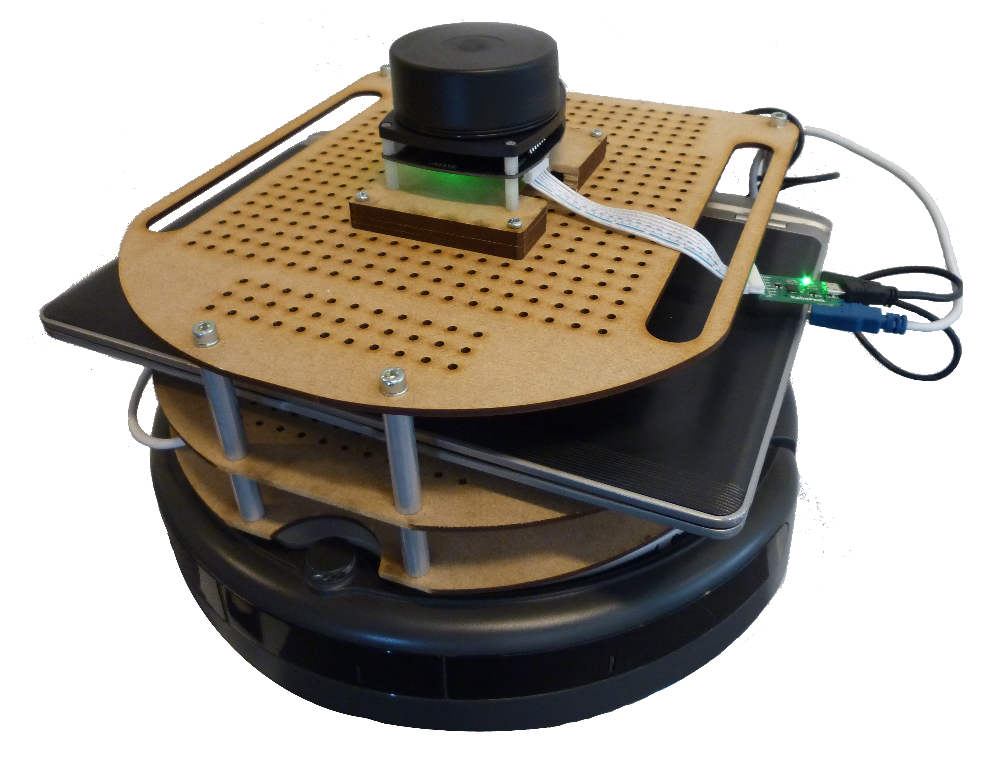
Our extended robotic platform
See
Think
Act
Notes:
Mounted range sensor, provide information needed during the See phase.
Space for our laptop, where the highly computational thinking phase takes place.
iRobot Roomba, used for its actuators and onboard sensors, during the Act phase.

Slide 10
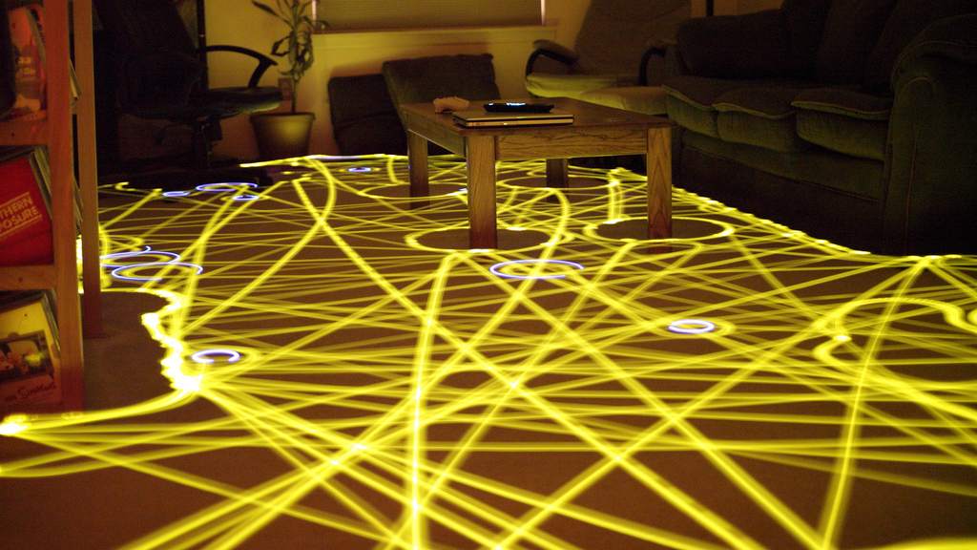
Roomba Platform
Low cost
A few onboard sensors :
Encoders (distance & angle)
Tactile sensors and “safety sensors”
Notes:
iRobot Roomba is originally used a low cost, autonomous vacuum cleaning robot.
As you can see on this picture, the original autonomous vacuum function is not very optimal.
Doesn’t know environment nor its location.
Results in a very “robust” “bug-type” navigation, using only its tactile sensors.
To accomplish this task, a few onboard sensor are also of use to us :
Encoders, to approximate the distance and angle of the robot, by looking at the rotation of the wheels.
Safety sensors , to notice if the Roomba is at an edge of a cliff, is lifted or has bumped into an object.

Slide 11
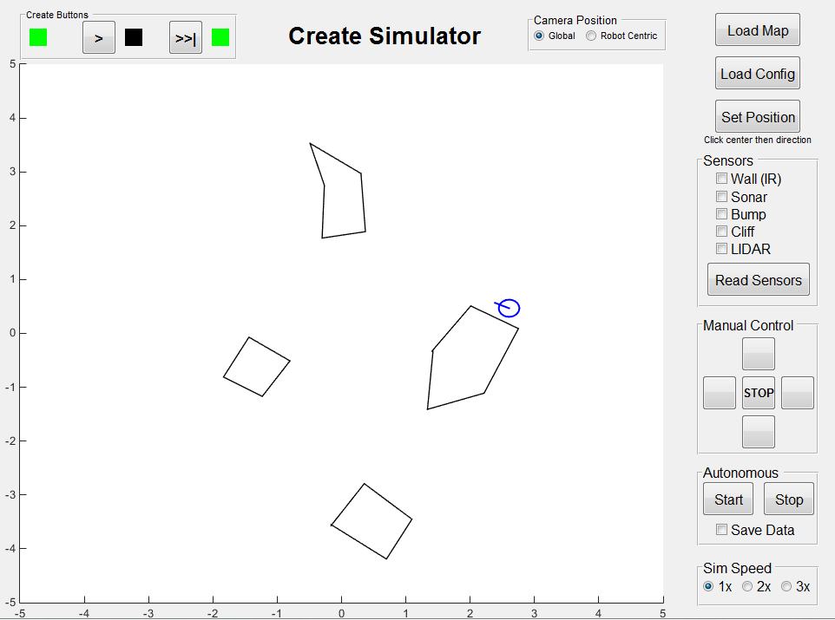
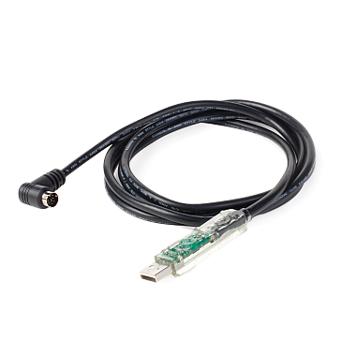
Roomba Communication
iRobot released Serial Communication Interface
A communication cable had to be made
MATLAB as main programming language
Communication toolbox
Simulation toolbox
Notes:
Important thing made project possible iRobot, released the SCI
This describes the way to communicate with the Roomba.
Cable needed to do this had to be made, not a standard accessory provided by the manufacturer.
The release of the communication parameters of the Roomba have lead to several toolboxes, available in MATLAB.
Examples are communication toolbox, which makes it possible to use function interact with the Roomba
A simulation toolbox, witch uses the same syntax as the communication toolbox, to test virtually a navigation algorithm, before implementing it on the real robot.
Those to toolboxes have made it possible to use MALTAB as main programming language.

Slide 12
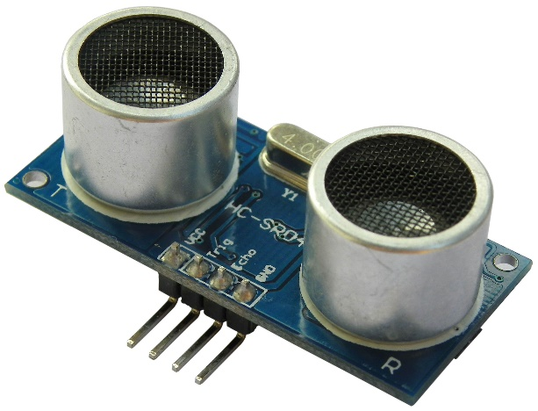
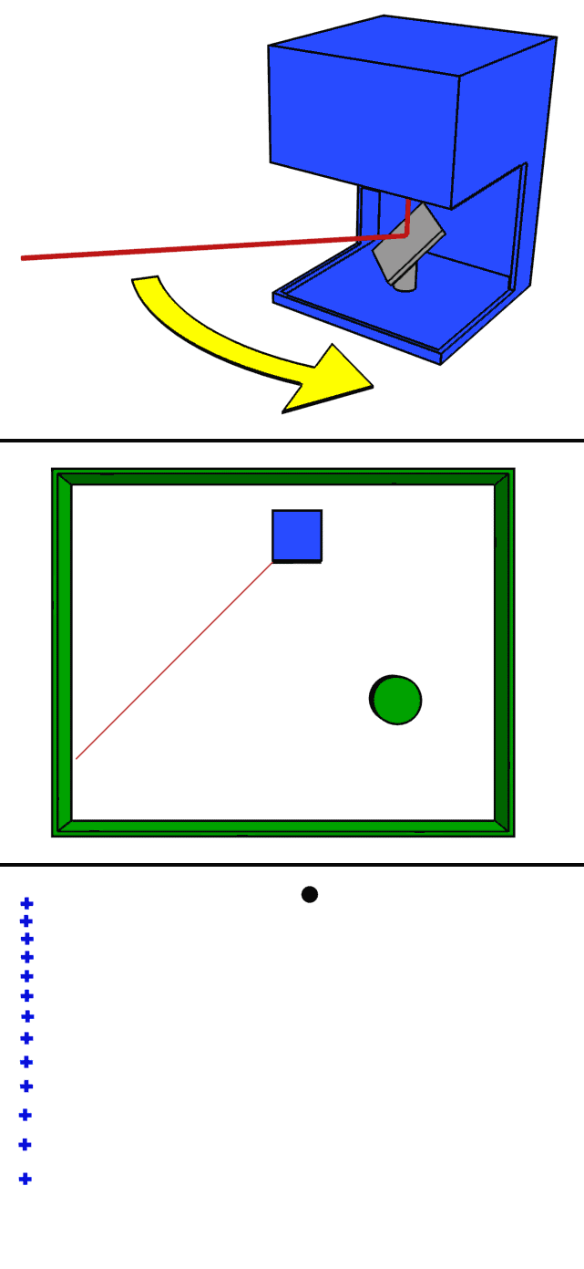
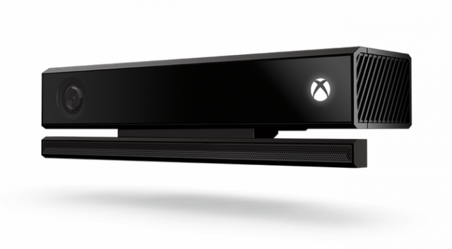
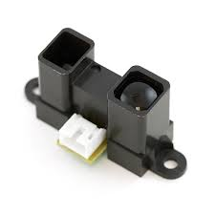
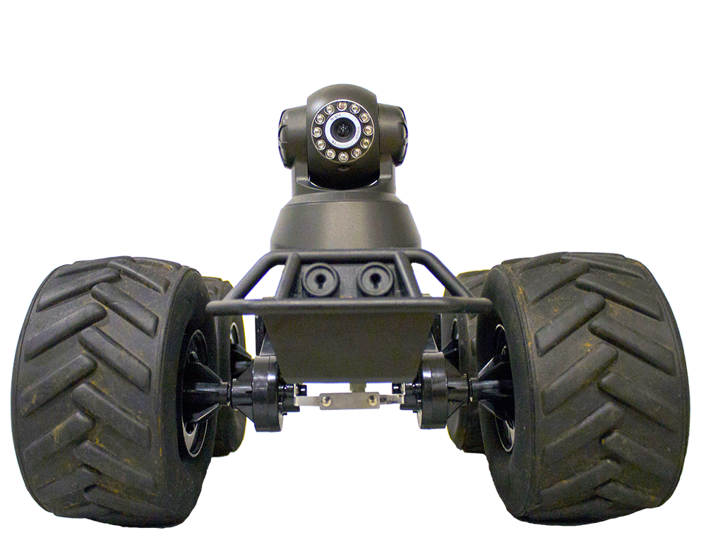
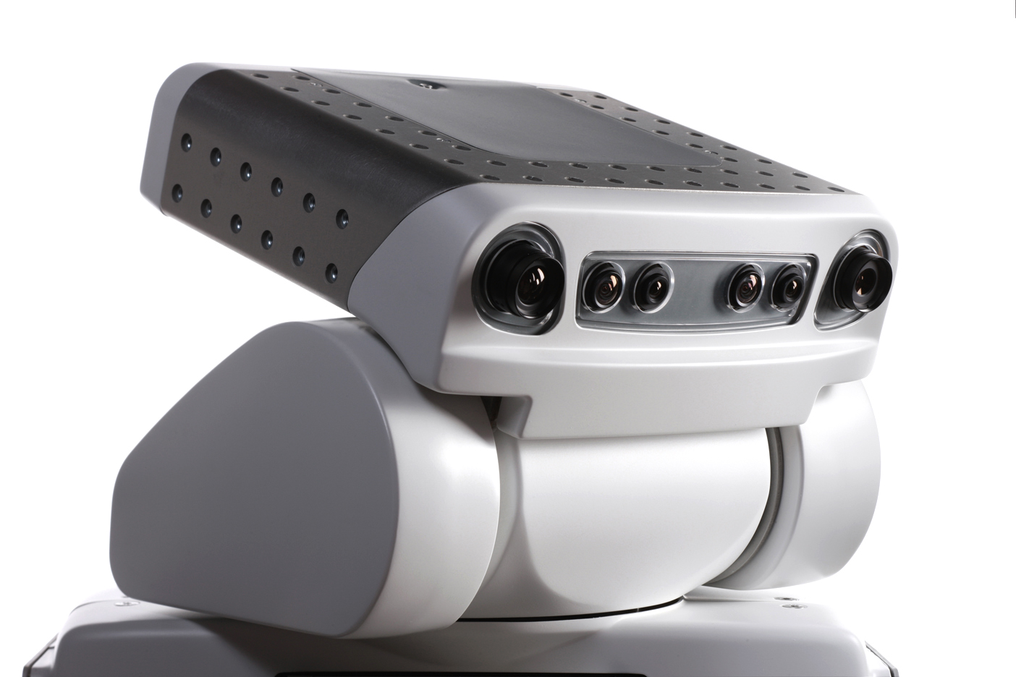
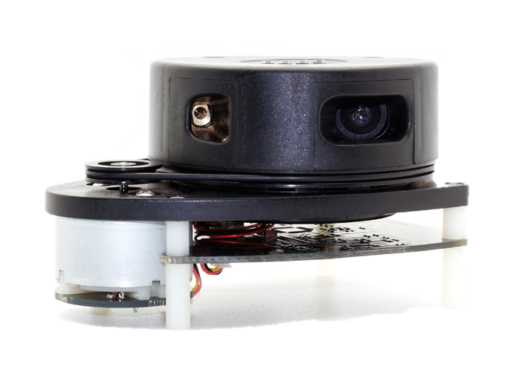

Sensor: Two Types
Sensor: RPLidar
Notes:
2 Groups: Range and Vision
Vision: Camera’s, Short Range and require some kind of process to extract useful information.
Range Sensor: Return ranges, Sonar and Infrared, Cheap, but noisy and require Matrix
LIDAR: High accuracy but expensive
GIF: Blue dots end points of measurements, lidar returns distance from dot to sensor

Slide 13
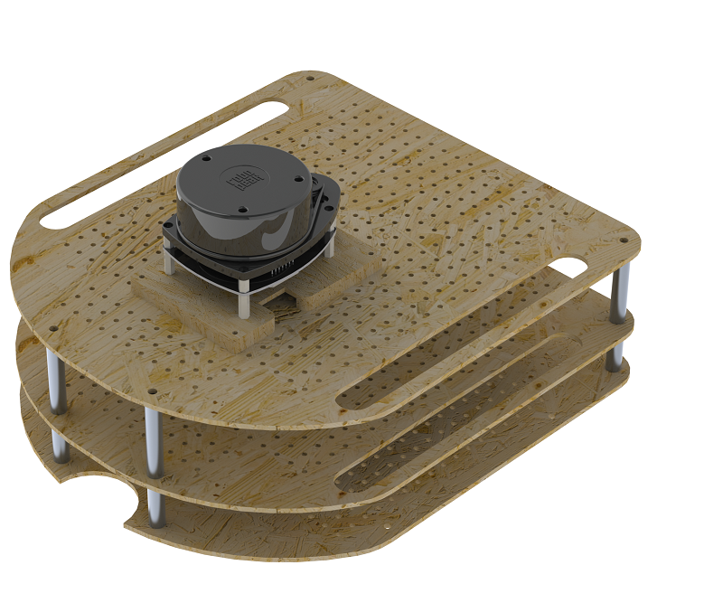
Extended Platform
Mounting platform for sensor and laptop
Requirements:
Easy to reproduce
Extendable
Flexible
Minimal modifications
Notes:
STANDARD ROOMBA HAS NO MOUNTING POSITION FOR ADDITIONAL SENSORS OR LAPTOP
REQUIREMENTS:
REPRODUCE AND FABRICATE
EXTENDABLE
MOUNTING POSITIONS ALSO USABLE FOR OTHER PLATFORMS
MINIMIZE MODIFICATIOSN TO ROOMBA ITSELF

Slide 14
Agenda
Purpose
Introduction
Robotic platform
Methods
Demonstration
Critical reflection
Future work
Notes:
In methods we will explained in more detail the algorithms that are used to give the robot the ability to navigate autonomously.

Slide 15
Methods
Localization (Think)
Obstacle Avoidance (Think)
Roomba Actuators (Act)
Lidar, onboard sensors (See)
Path Planning
(Think)
Once, before navigation starts
Until goal is reached
Notes:
Overview of methods
Note that the Path Planning is just performed once, before the actual navigation starts.
Then, the See Think act cycle in performed until the goal is reached.
This will ùse the LIDAR and onboard sensors to sense its enviroment,
The Localisation and obstacle avoidance during the think phase
And the actuators of the Roomba to performed the planned motion of the think phase.
Let’s start with the Path Planner !

Slide 16
Path Planning
“How do I go from my start to my destination position?”
Objective:
Time
Length
Distance to obstacles
Chosen Path Planning algorithm : Voronoi Diagram
Safest path is computed
Notes:
The PP finds the answer to question “how to I go from my start to my destination position”
Each PP has a certain objective, a quantity to optimize:
The most obvious could be reducing the time between those to positions,
But it could also be to reduce the total length of the path,
Or chose a path which maximizes the distance between each obstacle.
This could be seen as the “safest” path, between the start an destination position
The chosen Path Planner is based on the Voronoi diagram.
This method maximizes the distance of the path, with respect to the known obstacles.
This is favorable, because safety is the most important factor is this project, not speed.
In what follows, I will present you a few steps to illustrate the working of our path planner.

Slide 17
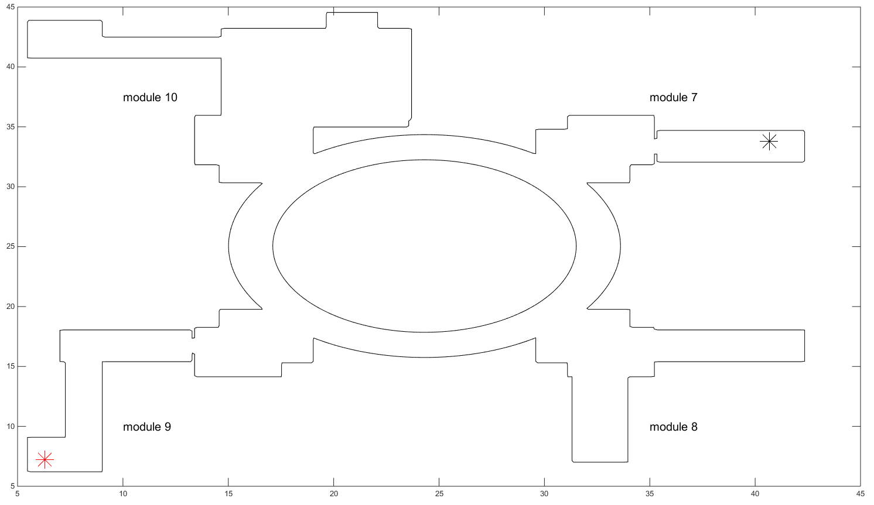
Voronoi Diagram
Input : Map, start and destination position
Notes:
As said before, the Voronoi Diagram needs a map of its environment.
This map contains the static obstacles of the environment where the robot has to navigate.
The start position and destination position are also shown.
The black star represents the start position and is located at module 7
The red star represents the destination position and is located at module 9

Slide 18
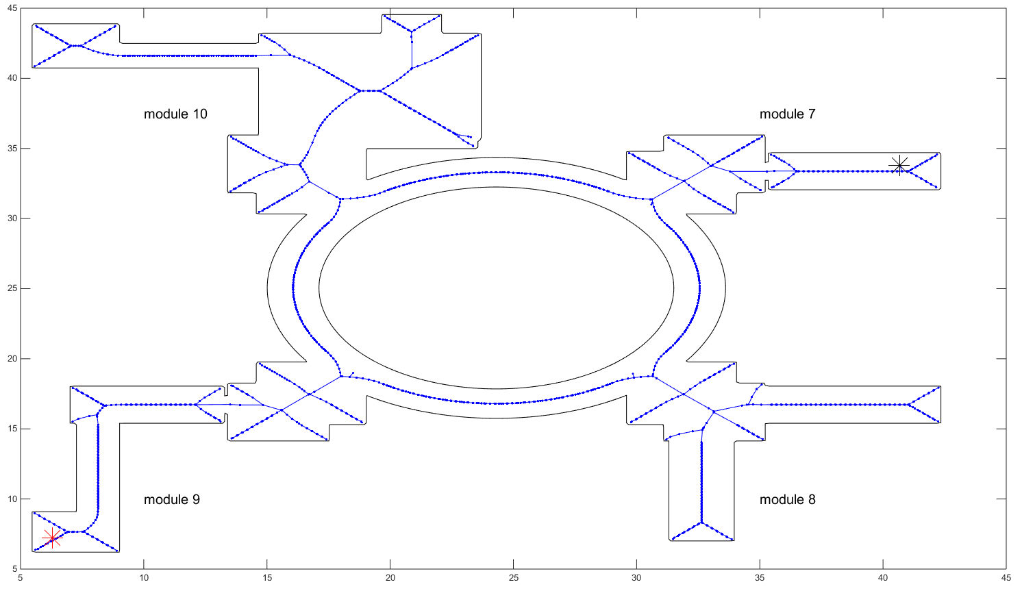
Voronoi Diagram
Output: Possible roads
Notes:
With this given map, the voronoi calculates the possible roads, as far away of the obstacles, shown here in blue

Slide 19
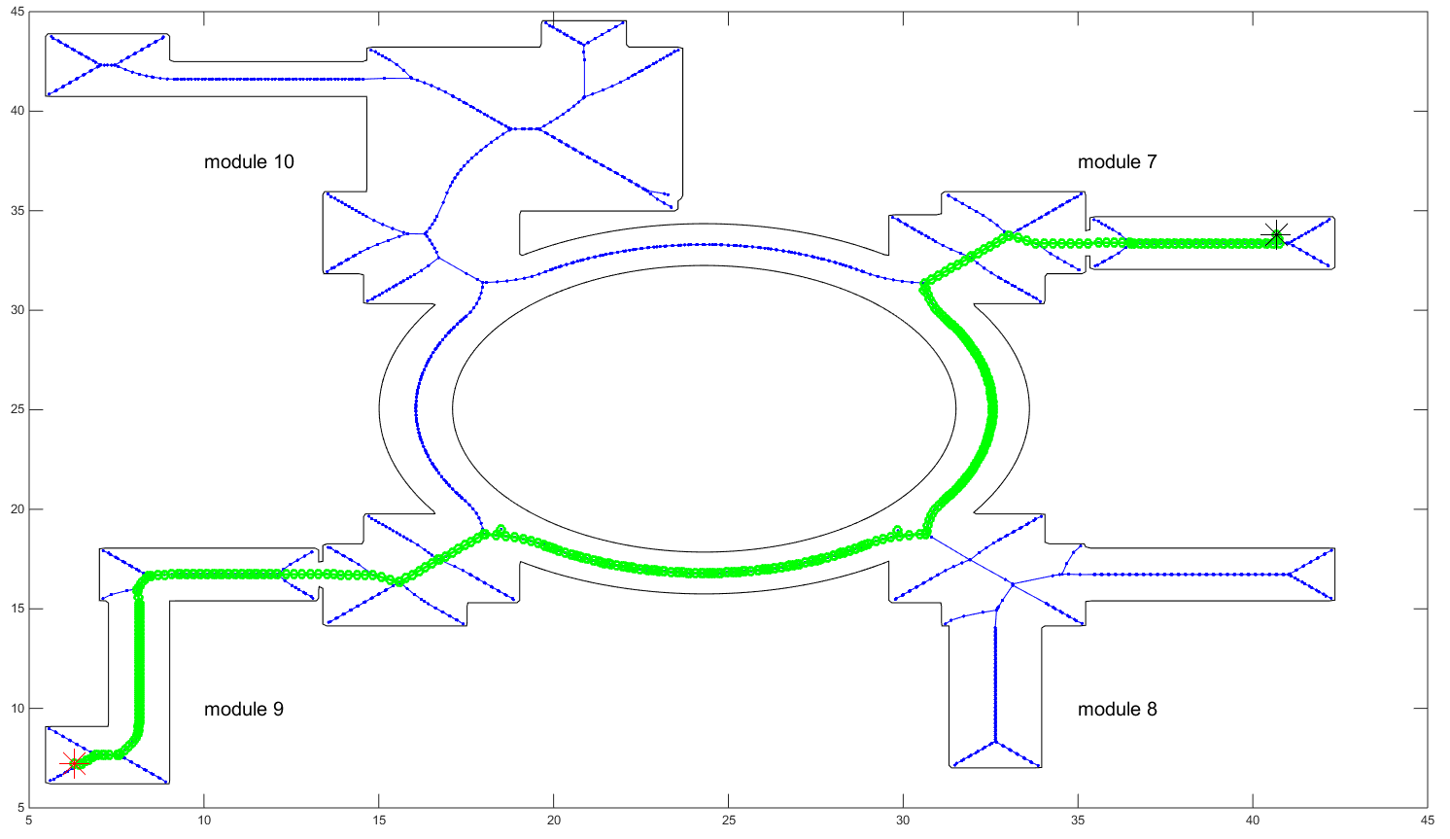
Voronoi Diagram
Output: Shortest set of roads
Notes:
The last step consists in finding the shortest path between the start and destination position, given the possible roads calculated earlier.
This is shown here in green.
We have now a working path planning algorithm.
Let’s now explore our implemented Localization algorithm.

Slide 20
Localization: General
“Where am I?”
Global Positioning
Position Tracking
Used for path planning and obstacle avoidance
Possible solutions:
Dead Reckoning
GPS
Markers
Extended Kalman Filters
Particle Filters (Monte Carlo)*
Notes:
Localization is an estimation problem `that answers the question “Where am I?”
3 Major problems:
Global Positioning
Position Tracking
SLAM
The robot’s position is both used in pathplanning and obstacle avoidance.
Possible Solutions:
DeadReckoning
GPS
Kalman
Particle Filter

Slide 21



Monte Carlo Localization
1.
2.
3.
Notes:
1. Initial step: UNIFORM DISTRIBUTION
2. Sensor update: the robot detects a door. It assigns a weight to each of the particles. The particles which are likely to give this sensor reading receive a higher weight.
3. Resampling: the robot generates a set of new particles, with most of them generated around the previous particles with more weight.
It now believes it is at one of the three doors.
These steps conclude the global positioning

Slide 22



Monte Carlo Localization
4.
5.
6.
Notes:
4. Motion update: All particles moved
5. Sensor update: the robot detects no door. It assigns a weight to each of the particles. The particles which are likely to give this sensor reading receive a higher weight.
6. Resampling: the robot generates a set of new particles, with most of them generated around the previous particles with more weight.
It now believes it is at one of two locations.
First cycle

Slide 23

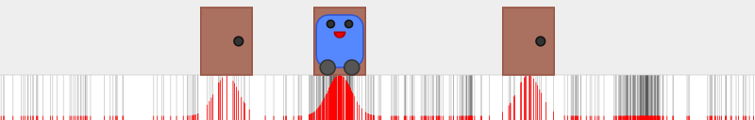
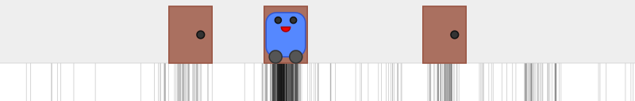
Monte Carlo Localization
7.
8.
9.
Notes:
7. Motion update
8. Sensor update: a door.
9. Resampling: the robot generates a set of new particles, with most of them generated around the previous particles with more weight. The robot has successfully localized itself.
The robot is now pretty certain about its location

Slide 24
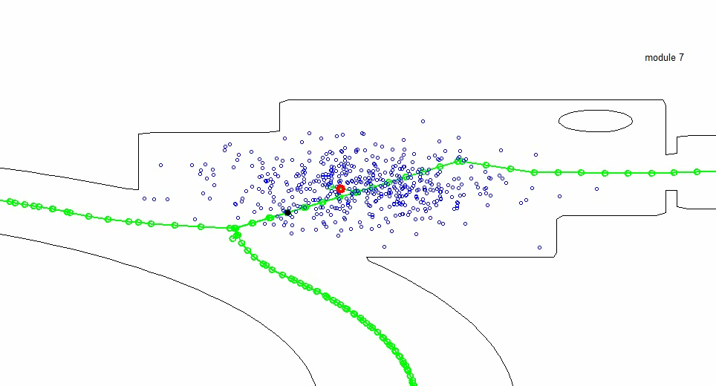
How does this look?
Notes:
Particles: BLUE
Chosen position estimate: RED
Green Path
The initial step shows the estimated position in red after the robot has sensed the environment: SENSOR UPDATE
Each step the cloud moves forward according to the odometry measurement provided by the wheel encoders: MOTION UPDATE
Lastly you can see that the cloud gets smaller every step, which is called the resampling step.

Slide 25
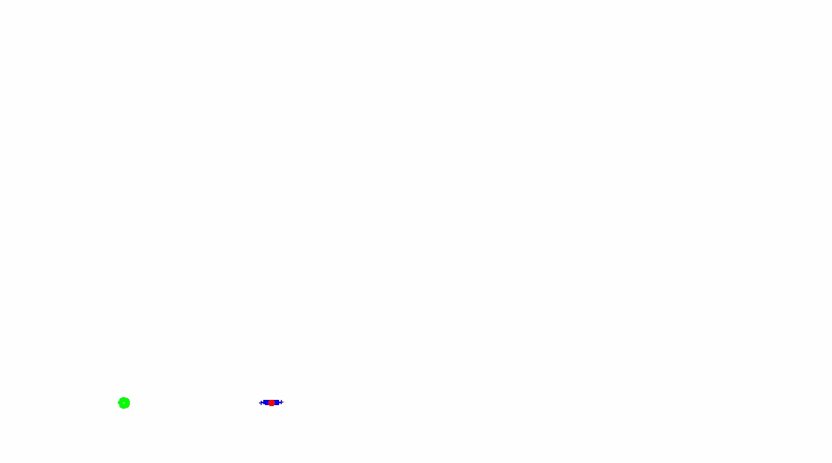
Localization: Motion Model
Notes:
Ìn this animation you can see that after each step noise is added to the odometry sensor values, the green point is the start position after which the robot moves forward, in red the exact position is visible if there was no added noise and in blue the particles are shown.

Slide 26
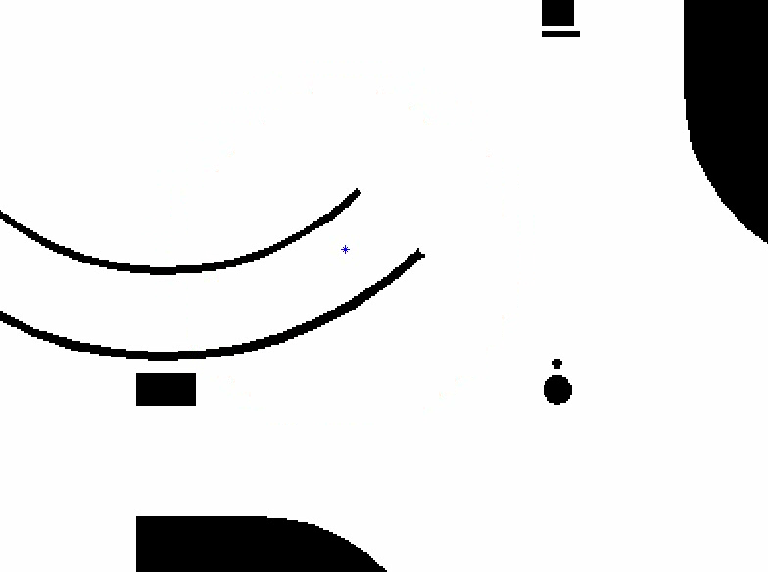
Localization: Sensor Model
Compare real with simulated measurements and assign a “weight”
Simulated: Ray-Casting
Models:
Sensor Noise
Unmapped obstacles
Random Errors
Notes:
assign a weight to the particles, this weight is a probability for a particle to be the correct position estimate.
Simulated measurements needed for each particle
These simulated measurements are calculated for each possible location of a particle.
Then these measurements can be compared with the real measurements of the LIDAR sensor.
Additionally the sensor models also takes in account sensor noise, unmaped obstacles and random errors.

Slide 27
Obstacle Avoidance
Follow the path calculated by the path planner
Find a collision free trajectory
Usage of scan made by LIDAR-sensor
Knowledge of the geometry of the robot
Chosen algorithm: Vector Polar Histogram
Notes:
OA has two main goals :
Follow the path calculated by the path planner
Find a collision free trajectory, if there are unknown obstacles on that path.
For this to be possible, the OA use the measurement data of the LIDAR sensor.
It also has to know the geometry of the robot, to take this into account during the navigation.
The selected algorithm is the VPH.

Slide 28
Vector Polar Histogram
Tailor-made algorithm for laser sensors (polar coordinates)
Takes actual speed into account
Changes robot speed if necessary
Changes made to original algorithm:
Geometry of robot
Circular motion
Notes:
Several positive aspects, which convicted us to implement it:
Laser sensors,
speed of the robot into account and can modify when necessary
A few changes were made to the original algorithm, mainly
The methods used to take the geometry of the robot into account,
We have also implemented circular motion.
I will show you now, in a few figures, the working of our OA algorithm.

Slide 29
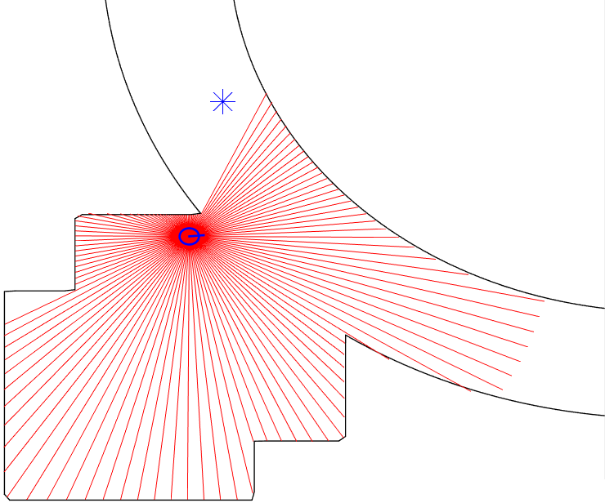
Vector Polar Histogram
Original laser scan = distance to each obstacle
Notes:
The OA receives the target position (blue start) and the LIDAR data (red lines).
The LIDAR data consists of obstacle points, This is a distance and angle, with respect to the center of the robot and its orientation .

Slide 30
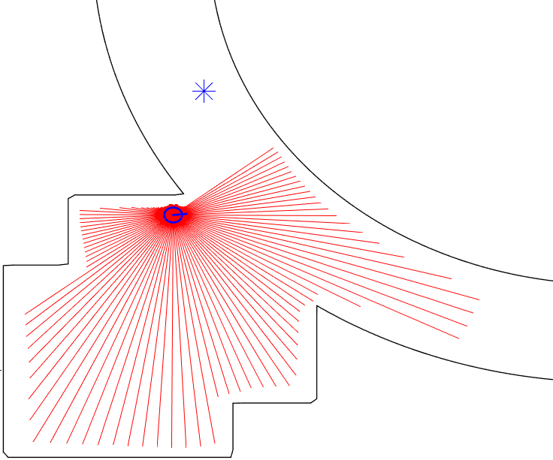
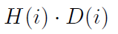
Vector Polar Histogram
Distance to each obstacle → Distance that the robot can move towards each obstacle
Notes:
Now, the algorithm has to take the geometry into account.
This is done by calculating the distance that the robot could move, towards each direction, before reaching the obstacle point.
Lets define this as capital D.
I indicates the index of the measurement.

Slide 31
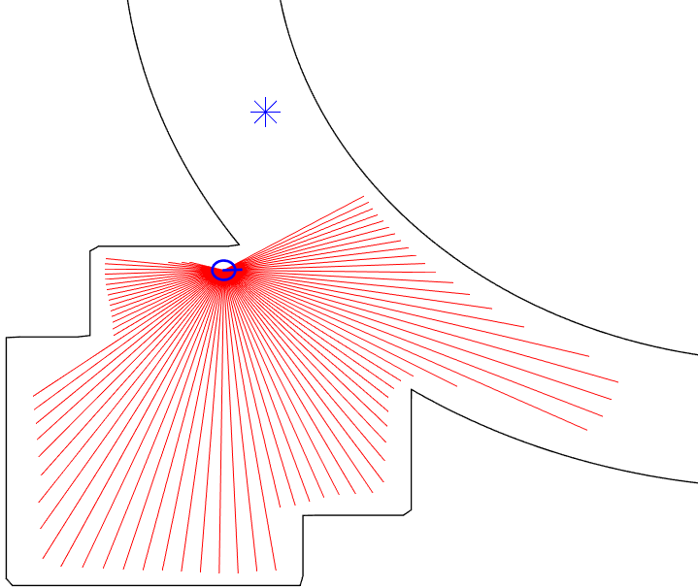
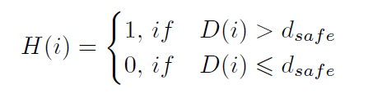
Vector Polar Histogram
Direction with distance that robot could travel within one cycle time are eliminated
Notes:
After that, the OA has to deside if this distance is safe or not.
A safe distance correponds to a distance that the robot WONT reach within one time cycle.
As you can see, the distances on the top of the robot are set to zero, because they are smaller as the safe distance.
Let me define now H, witch is either 1 or 0, depending if the distance is safe or not.
What is now drawn on this plot is H times D .

Slide 32
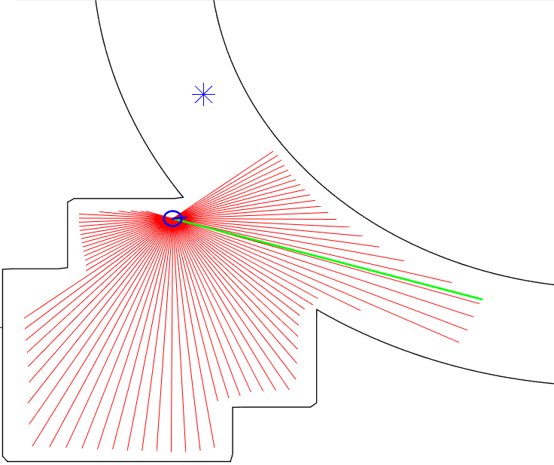
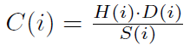
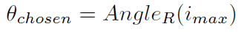
Vector Polar Histogram
Direction is chosen according to :
Notes:
The final step consistof calculating the cost function.
The index at which the maximal value is found, gives the angle which the robot has to turn, to bring the robot eventuallyto its target position.
In de numerator we find the previously defined H times D.
In the denumeratoris a simple goal-effort saving function.
This function weights the closeness to the goaland the effortto achieve this direction.
As you can see, the robot is currently attackedto the open space, on the oppositeside of the spiral.
This is because of the Distance factor in the cost function resulting in asafer navigation.
This is in the same spirit as the chosen path planner, which places safety over speed.

Slide 33
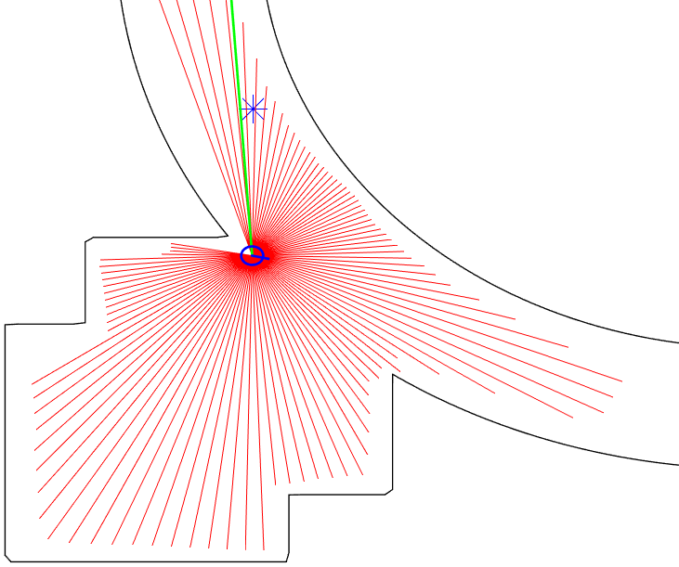
Vector Polar Histogram
Safe, but still goal seeking
Notes:
But of course, once that the target position is in sight of the robot, it will chose the coresponding direction !

Slide 34
Agenda
Purpose
Introduction
Robotic platform
Methods
Demonstration
Critical reflection
Future work
Notes:
Let us now show you, the final result by showing you a video.

Slide 35
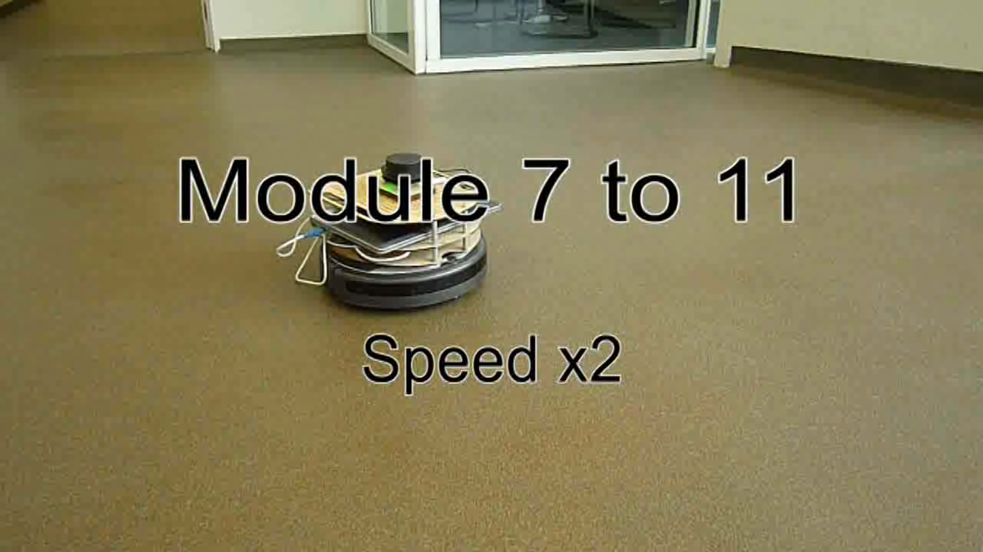
Demonstration
Notes:
During this experiment the robot had to move from Module 7 to Module 11, which means it has to do a full circle on GroupT and enter a corridor at the end of the experiment. An approximate position of the robot is given. Here the initial steps are shown as the robot leaves the starting module and the enters the spiral. In the top left corner the current robot position and path is displayed. Whilst navigating the robot makes a smooth trajectory by moving in curves, when the robot receives the command to rotate more than 40 degrees it turns on the spot.
The localization whilst on the spiral has difficulties as will be explained later, when the robot reaches a module it has the ability to update its position more accurately.

Slide 36
Agenda
Purpose
Introduction
Robotic platform
Methods
Demonstration
Critical reflection
Future work
Notes:
Even though the robot is able to navigate on Group T, there are still some difficulties we would like to discuss now:

Slide 37
Critical Reflection
Localization
Difficult position estimates on spiral
Need for precise odometry
Notes:
The first weakness of our implementation is the due to the special nature of the building.

Slide 38
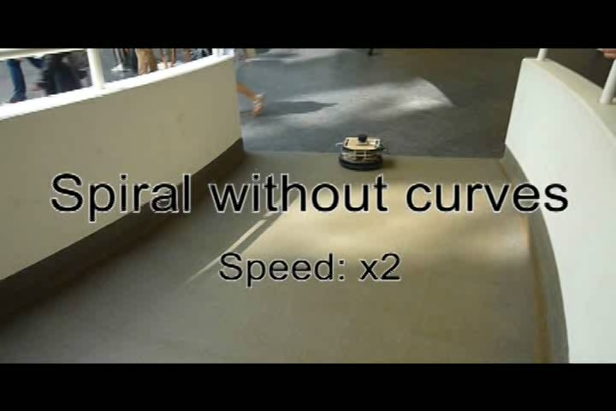
Video: Spiral without curves
Notes:
The spiral on groupt is not only architectually special, but also a special shape for robots. Unique shapes are required by the localizaiton algorithm to provide accurate results, but this is not the case while the robot is on the spiral.
This could be improved if we had accurate odometry sensors, however we found that the odometry sensors are very imprecise whilst taking curved paths due to a static error on the wheel encoder measurements which we could not resolve, this is why we made the robot move without curves during this experiment.

Slide 39
Critical Reflection
Localization
Difficult position estimates on spiral
Need for precise odometry
Obstacle Avoidance (Video)
Designed for static obstacles
Considers dynamic obstacles as static
Notes:
Another weakness is the simplifcation is made in the implementation of the obstacle avoidance algorithm, VIDEO

Slide 40
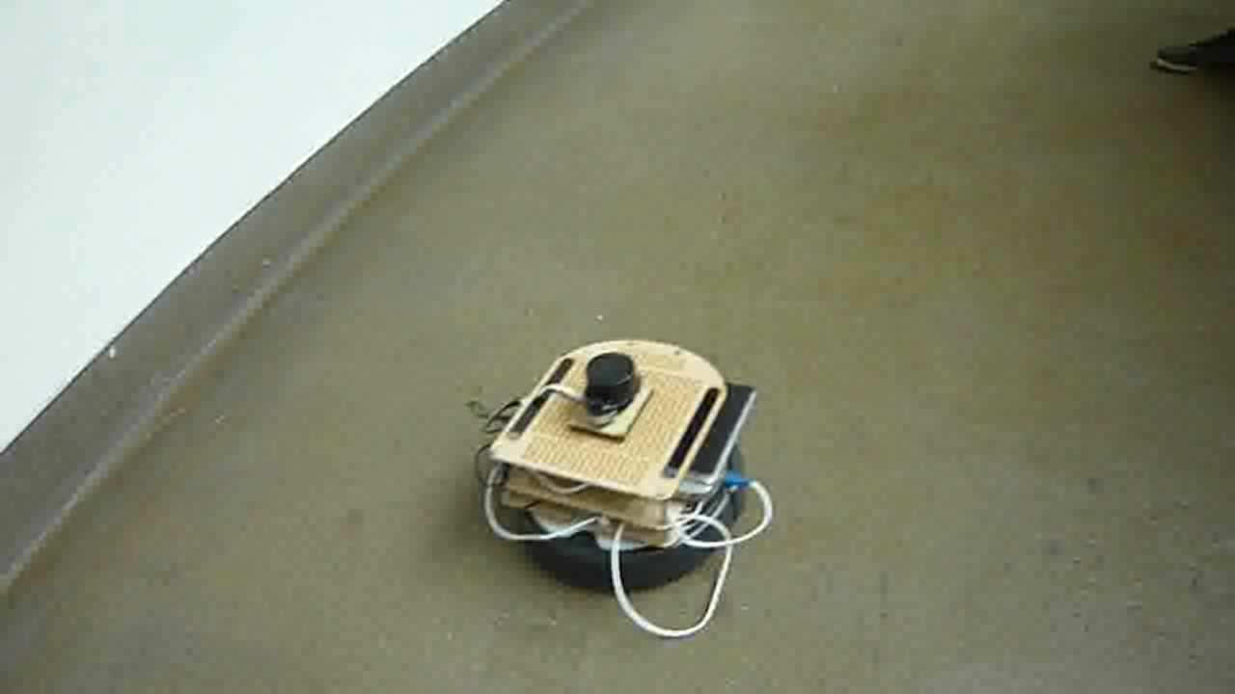
Video: semi-static obstacles
Notes:
the VPH algorithm that is currently implented is designed for static obstacles only, this means that all encountered obstacles are seen as static. In this first example this simplification results in good results. You see that the robot takes into account the people in a correct manner and navigates around them

Slide 41
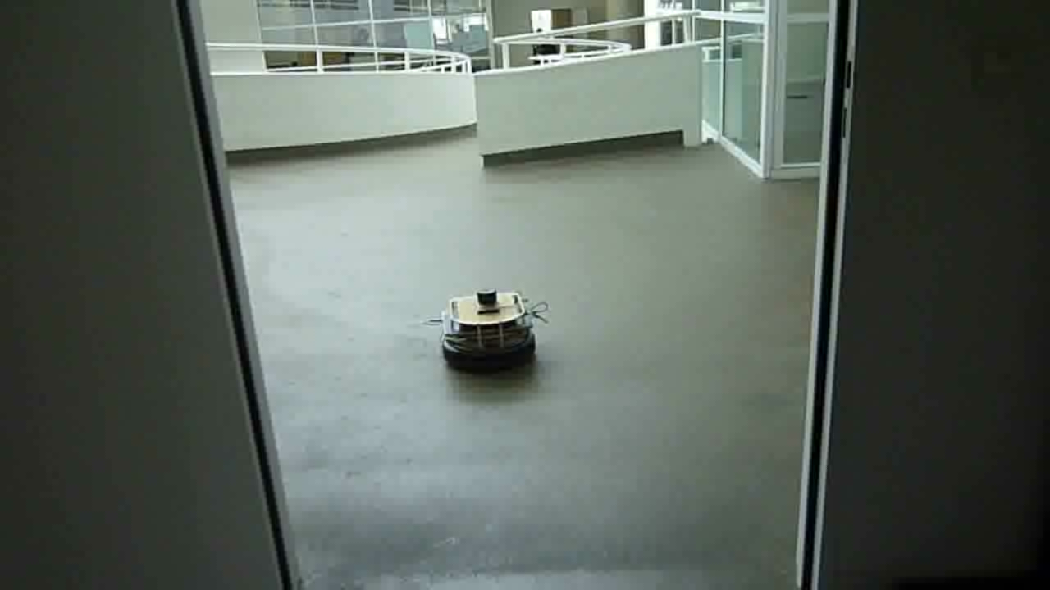
Video: dynamic obstacle seen as static
Notes:
In this example you can see the robot succesfully entering a corridor then then the robot encounters a highly dynamic object, the robot thinks decides to turn around because of its close proximity to the obstacle, however by the time it decides to do this the obstacle is already gone. This solution is safe however not ideal.

Slide 42
Critical Reflection
Localization
Obstacle Avoidance
Sequential nature of MATLAB code
Localization (Think)
Obstacle Avoidance (Think)
Roomba Actuators (Act)
See: Lidar, onboard sensors
Notes:
Another point which leads to difficulties is the sequential nature of MATLAB code.
This means we cannot use multithreading to perform multiple calculations at once, a possible advantage of this would be the possibility to use the latest sensor data without having to wait for it.

Slide 43
Agenda
Purpose
Introduction
Robotic platform
Methods
Demonstration
Critical reflection
Future work

Slide 44
Future work
Make the robotic platform embedded
Use single board computer to communicate with an external computer
Use single board computer also as computational power
Adaptation of methods is needed !
Dynamic model of the Roomba
Better Obstacle Avoidance methods are available
Tracking the person following the robot
Notes:
Of course, our work done so far can be improved !
To make the robot more autonomous, we could use single board computers (for example ,the Raspberry Pi mounted on Roomba)
This is mainly due to the fact that the limiting autonomy of our platform is the battery of our laptop and not the battery of the Roomba.
The single board computers could be used just as data senders to an external computer. This computer could handle the computational extensive part of the algorithm
A step further could also be taken, by using only single board computers, but reducing the computational power.
This will imply the adaptation of the localization algorithm, which requires at this time to much calculations to be performed, within reasonable time limits, by signle board computers .
Another important improvement could be an in depth analysis of the dynamics of the robotic platform.
This could lead to the usage of more evolved algorithms, taking the dynamics into account and making a smoother trajectory.
The robot at this point is unable to track the person that is following the robot, this is also something that needs attention

Slide 45
End of presentation
Thank you for your attention
Notes:
Lastly we would like to thank our supervisors Mr. Slaets and Mr. Vandeurzen for their assistance which made this project succesful.

